Slide 1
Effective Writing and Editing for Publication
LeAnne Hardy
ICETE C15

Slide 2
Choose a topic
What are the issues that come up time and again in your church or school for which you don’t find books or articles?

Slide 3
Choose a topic
Put your idea succinctly in one or two sentences that you could share with a publisher before the elevator gets to his floor.
(This is called an “elevator pitch.”)

Slide 4
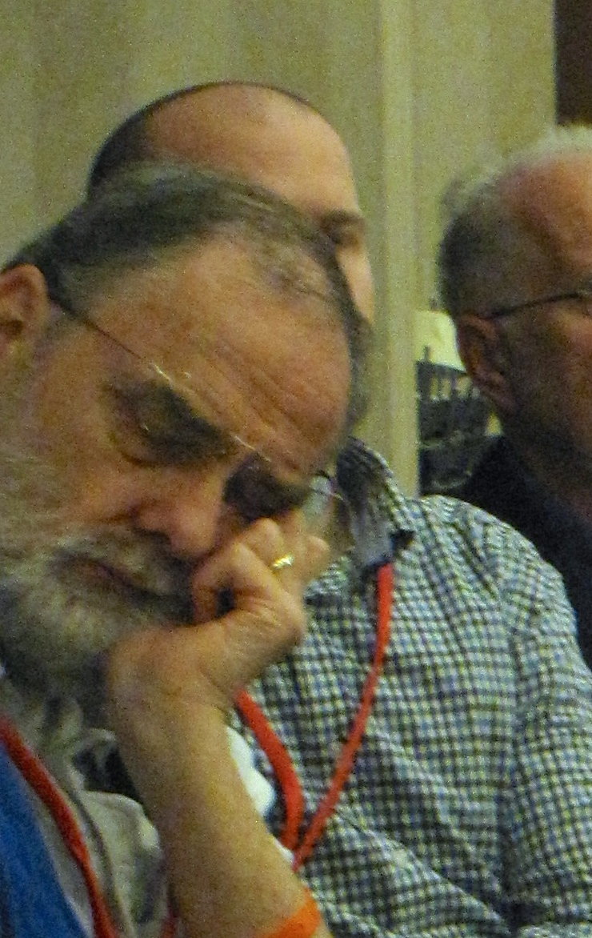
I you don’t want this to be his reaction…
…you must grab his attention with your focused idea.

Slide 5
Choose your target audience
For whom is this book or article intended?
  Christians or pre-believers?
  Theological professionals or laypeople?
  Rural or urban?
  Young people or older adults?
For whom is this book NOT intended?
A book for “everyone”
will probably not be effective with anyone.

Slide 6
Create an outline
What are the main aspects of this problem that need to be covered and in what order?
Make a tentative outline.
(You can always change it later.)

Slide 7
Write that first draft
What schedule can you commit to for accomplishing this task?
  30 minutes every day? Morning or evening?
  2 hours on the weekend?
  More?

Slide 8
Write that first draft
What language will you use to most effectively reach your target audience?
  English or another world language will reach a wider audience.
  The heart language will have a deeper impact.

Slide 9
Get feedback from others
How can your book be better?
Who could help you make it better?
  Consider colleagues and members of your target audience who can give you honest feedback. “I loved it!” may feel good, but it isn’t helpful.

Slide 10
Rewrite
Edit using the principles in the following part of this workshop
Get more feedback
Rewrite again
Get more feedback
Rewrite again
Repeat as many times as necessary.

Slide 11
Part 2: Effective Editing for Publication
Simplicity
  Short words (many, not numerous)
  Simple, direct sentences
  Based on William Zinsser, On Writing Well; the Classic Guide to Writing Nonfiction, Harper Collins (NY: 2001)

Slide 12
Not this:
“Long before he was declared a saint by the Church, Augustine, who lived from 354 to 430 AD, gained profound influence as both a Church Father and a Christian Platonist philosopher—defending the doctrine of the Trinity, defining the epochal idea of religious grace, delving into the inner relationship between God and soul, and much more that impacts us even today as we seek to integrate our Christian lives with culture around us.”

Slide 13
Or this
“In particular; taking advantage of the fact I am seeking in this truly august house of the elected representatives of our people, which all of us must respect, I would also like to salute and thank the honorable deputy president, Phumzile Mlambo-Ngcuka, whose extraordinary energy and dedication to her work and the welfare of all our people, whose ability to demand and get results from all of us without sounding like a shrew, whose humility and aversion to personal aggrandizement in any form, whose humanity and empathy shine through in the most adverse circumstances, whose capacity to stand up for the species of her gender, remain feminine, and still exercise effective leadership in what is still a predominantly masculine world, whose courage rises with danger, as the Honorable Inkosi Buthelezi said when he spoke of Albert Luthuli, whose training as a conscientious teacher she cannot hide, and whose instinctive comradeship and ability to listen and admit her own and the mistakes and failures of the Presidency, all serve as a glue that holds all of us together as one team—even as we see ourselves as superstars.” (187 wds) President Thabo Mbeki, speech in Parliament quoted in The Star, Thursday, 14 June 2007

Slide 14
  Example:
  “Of the 701 words in Lincoln’s Second Inaugural Address, a marvel of economy in itself, 505 are words of one syllable and 122 are words of two syllables.” Zinsser, p. 69
  [One word out of ten is more than two syllables.]

Slide 15
Effective Editing for Publication
Clarity
  “Our national tendency is to inflate and thereby sound important.” (Zinsser, p.7)

Slide 16
Not Christian Jargon
It’s been two years since I was convicted, saved, and delivered. Now I’m on fire, really plugged in. I’m rooted in the Word and committed to a good body. I’ve been stepping out and moving in the gifts. I can hardly believe how God has been using me.

Slide 17
Effective Editing for Publication
Clarity
  Precise word
  Grammar
  Punctuation

Slide 18
Check grammar and punctuation
Chicago Manual of Style, 16th ed. Chicago, IL (Chicago University Press, 2010)
Christian Writer’s Manual of Style, Robert Hudson, general editor, Grand Rapids, MI (Zondervan, 2004)
Publishing company style guide
If all else fails, Google it!

Slide 19
Effective Editing for Publication
Clarity
  Precise word
  Grammar
  Punctuation
  Active not passive verbs
  Order and structure

Slide 20
Effective Editing for Publication
Clarity
  Order and structure
    Beginning hooks the reader
    Middle develops the idea
    End leaves the reader with one idea supported by the middle and propels the reader into the next chapter.

Slide 21
Effective Editing for Publication
Brevity
  Don’t take three pages to say what could be said in three paragraphs.
  Don’t take three sentences to say what could be said in a few words.
  Make every word count
    “Because”, not “due to the fact”
    “Now”, not “at this point in time”
  No repeated sentences
    Repetition comes from not trusting yourself to have said it well enough the first time.

Slide 22
Wordy Writing Exercise (167 wds)
The sentences in ths paragraph use far and above too many words to express the simple, uncomplicated idea that we will be able to communicate more effectively if we try to use fewer words. Use your pen to cross out all the unnecessary words in these sentences and shorten the paragraphs by at least twenty words if not more. When you are writing, it is very important to write a tight final draft. You don’t want to waste words repeating. You will want to make every world count. Don’t say the same thing twice in different ways. Make sure that every sentence contributes something new. You really don’t need all those unnecessary adverbs if you carefully choose active verbs to show what is happening. Then again you will find that words such as ‘very,’ ‘suddenly,’ ‘immediately’ won’t even be missed when you leave them out. In conclusion it is important to note that unnecessary words slow down your writing and make it just plain boring and repetitious.
[Do this exercise before you move to the next page.]

Slide 23
Wordy Writing (87 wds)
The sentences in this paragraph use far and above too many words to express the simple, uncomplicated idea that we will be able to communicate more effectively if we try to use fewer words. Use your pen to cross out all the unnecessary words in these sentences and shorten the paragraph by at least twenty words if not more. When you are writing, it is very important to write a tight final draft. You don’t want to waste words repeating. You will want to make every word count. Don’t say the same thing twice in different ways. Make sure that every sentence contributes something new. You really don’t need all those unnecessary adverbs if you carefully choose active verbs to show what is happening. Then again you will find that words such as ‘very,’ ‘suddenly,’ ‘immediately’ won’t even be missed when you leave them out. In conclusion it is very important to note that unnecessary words slow down your writing and make it boring and repetitious. [removed 79 wds]

Slide 24
Effective Editing for Publication
Accuracy
  Truth
    whether fiction or non-fiction
  Good research
    “…collect more material than you will use. Every article is strong in proportion to the surplus of details from which you can choose the few that serve you best—if you don’t go on gathering facts forever” (Zinsser, p. 59).
  Careful typing

Slide 25
Effective Editing for Publication
Unity
  Consistency of tense, person, and tone
  Aim—Why am I telling the reader this?
    “…every successful piece of non-fiction should leave the reader with one provocative thought that he or she didn’t have before. Not two thoughts, or five—just one.” (Zinsser, p53)

Slide 26
Go back to your elevator pitch. How can your refine the aim of your book to better challenge your reader?

Slide 27
Effective Editing for Publication
Originality
  What you say
    What do I have to say that hasn’t already been said?(The answer may come from your cultural context as in Africa Bible Commentary, South Asia Bible Commentary, etc. Answering this question will require marketing research.)
  How you say it
    How can I say it in a fresh and creative way that will grab the reader’s attention?

Slide 28
Effective Editing for Publication
Humanity
  Style
  Humor
  Universal emotions
Now you are ready to rewrite—again.

Slide 29
On Self-publishing
Self-publishing is an option we have today with Kindle, CreateSpace and others. It facilitates publications aimed at niche markets that are not commercially viable for major publishers. It is not an excuse to skip the steps of effective writing and editing.
Avoid companies that offer to “help” you, but want significant money up-front, especially for promotion, which you can do far more effectively than they can since you know your target audience better than they do.
With help, you can do most of the work yourself. The following on-line helps are things I have found useful.

Slide 30
A Few Self-publishing Helps
To hire me: http://www.leannehardy.net <editorial services> tab . (There ARE other editors out there. Look for someone with some understanding of your target audience.)
Print-On-Demand: www.createspace.com, www.IngramSpark.com
Book design: http://www.writing-world.com/publish/lulu.shtml
Or find a similar book whose layout you like and make yours look like that.
Save your layout as a pdf and view in two-page spread format. (On the <view> menu in Adobe)
E-books: https://janefriedman.com/how-to-publish-an-ebook/
Kindle e-book: www.kdp.amazon.com
Smashwords: https://www.smashwords.com
Free Kindle book Building Your Book for Kindle: https://kdp.amazon.com/help?topicId=A2MB3WT2D0PTNK

