Slide 1
Resourcing learning in a globalized world
Theological libraries
Katharina Penner, Director of Research/Learning Resources, TCM International Institute

Slide 2
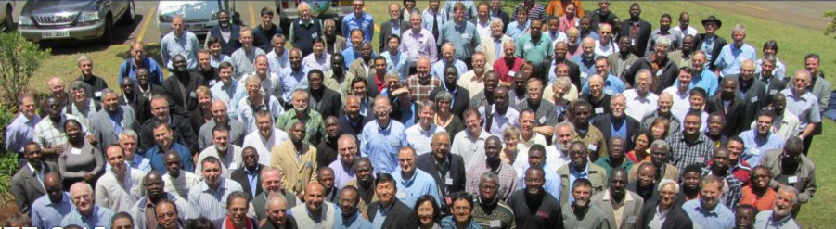
Reality of globalization and its effects on libraries

Slide 3
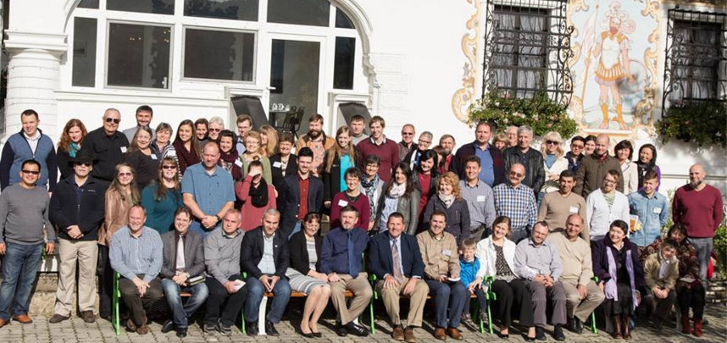
TCM International Institute
about 800 students studying at distance in 8 different CEE languages, incl. English

Slide 4
Disclaimers

Slide 5
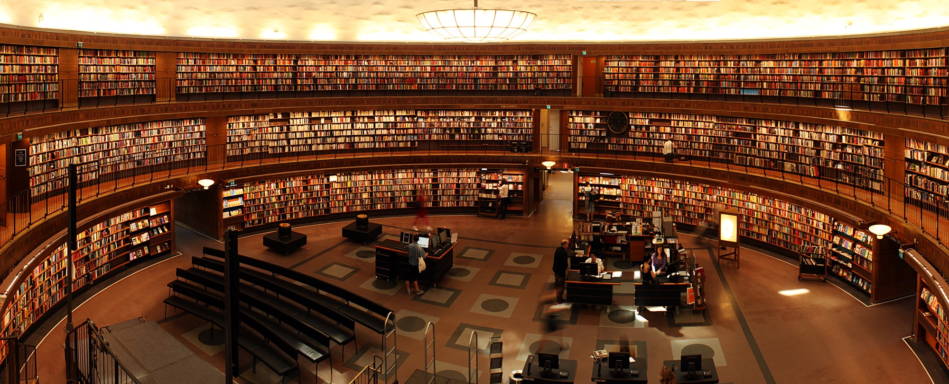

Slide 6
Resourcing learning vs. resourcing libraries
Conversation, interaction, attention to both content and process
Need to “speak three languages”: library, faculty, IT
Are they all “on the same page”?

Slide 7
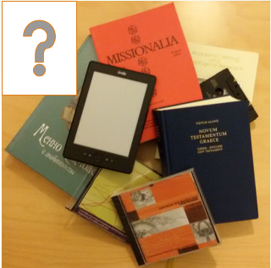
Collection development
What do we need?

Slide 8
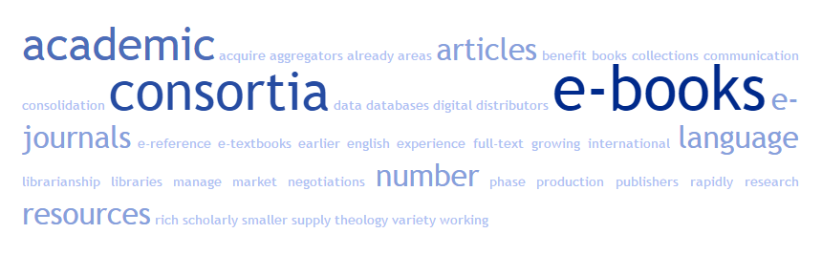
Collection development: e-resources

Slide 9
Examples (far from comprehensive)
Christian Library Consortium (ACL)
ABTAPL – consortial price for e-journals
Free, open-access resources:
  Global Digital Library on Ethics (GlobeEthicsLib, WCC), http://www.globethics.net
  STEP (Tyndale), http://www.stepbible.org
  Index Theologicus (complement to ATLA)
  Electronic Journals Library (Regensburg), DOAJ, Free theological journals on the web (comp. by ATLA)
  and many, many others…

Slide 10

InterLibrary Loan, document delivery

Slide 11
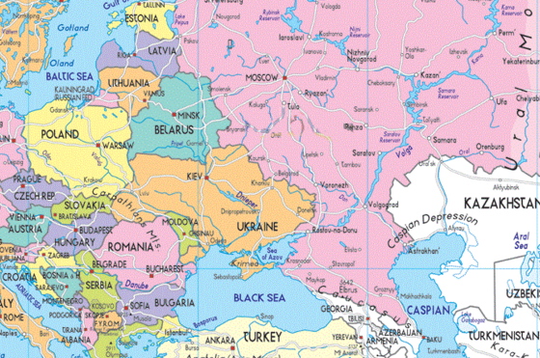
Partnering, networking (with local librarians, faculty, alumni)

Slide 12
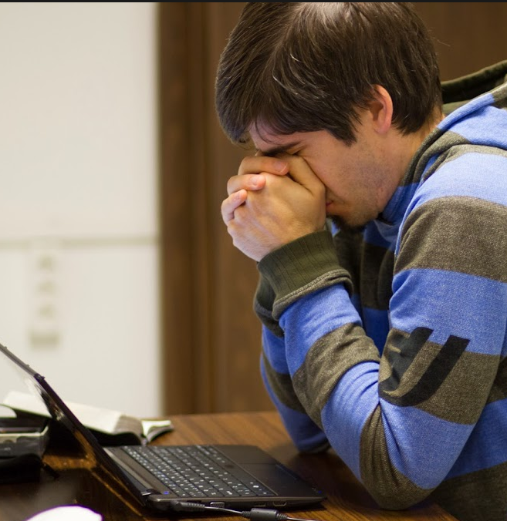
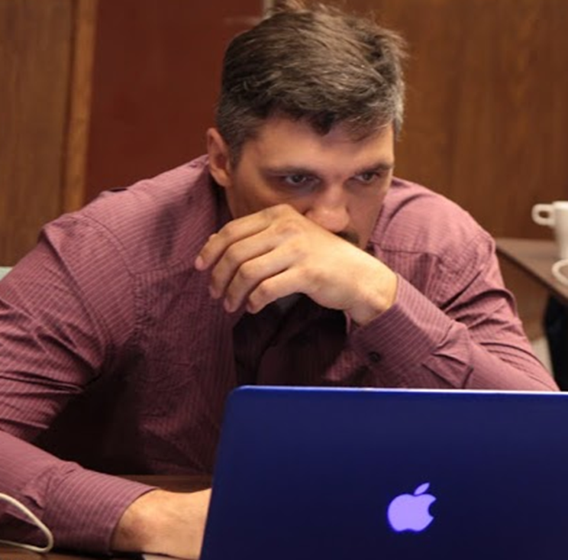
Distance/online platforms and libraries
Problems so far:
effective design of online courses
technological infrastructure, costs, constant changes, training
effective assessment
high drop-out rates

Slide 13
“Students’ perceptions of effective teaching” (2008 study in Newfoundland, Canada, paper read at 26th Annual Conference of Distance Teaching & Learning)
Resident programs
Distance programs
Respectful
Knowledgeable
Approachable
Engaging
Communicative
Organized
Responsive
Professional
Humorous
Respectful
Responsive
Knowledgeable
Approachable
Communicative
Organized
Engaging
Professional
Humorous

Slide 14
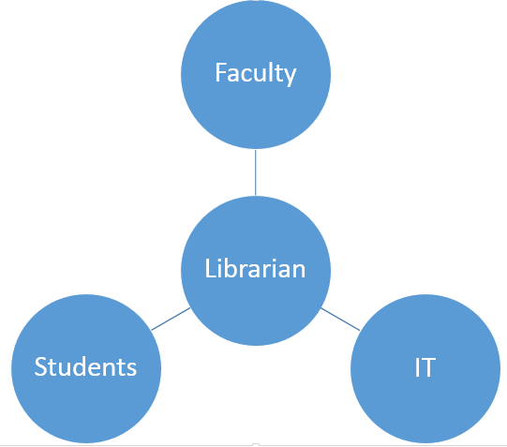
Library services
access to curriculum-relevant
  internet-accessible resources
document delivery services, ILL
partner with local libraries
communication at for students’ optimum hours
Training (information literacy), technical support
also "Standards for Distance Learning Library Services" by ACRL (2008)

Slide 15
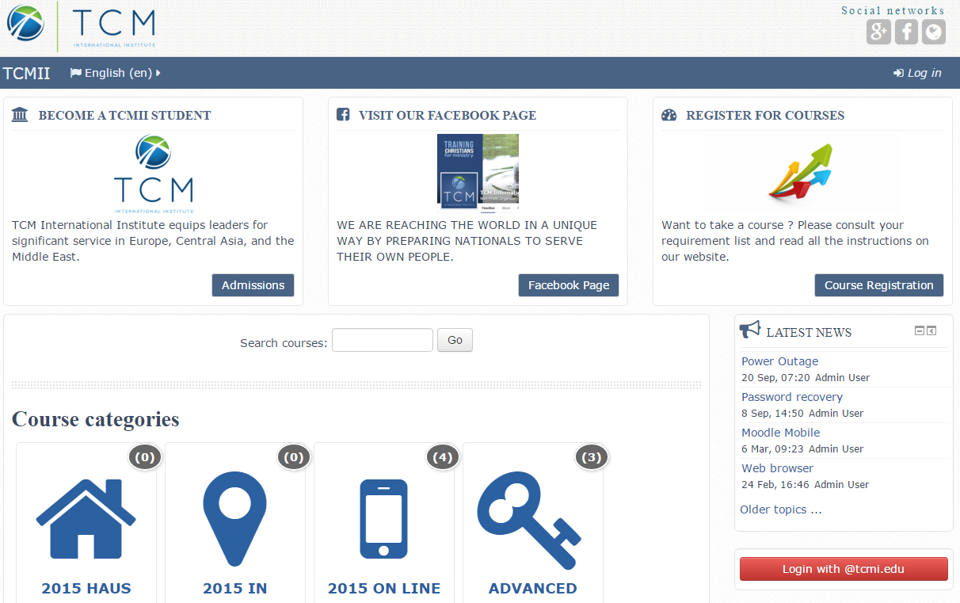
Library involvement on LMS
Macro-level (“library” course, link to library website, widget)

Slide 16
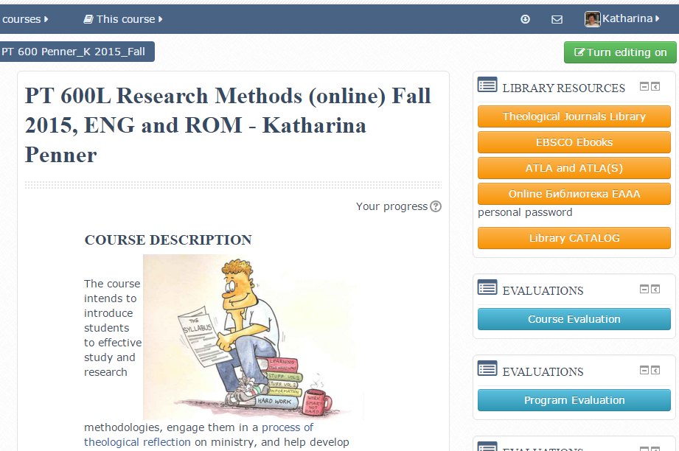

Slide 17
Library involvement on LMS
Macro-level (“library” course, link to library website, widget)
Micro-level (course-specific bibliographies, links to e-reserves, subject-specific LibGuides)

Slide 18
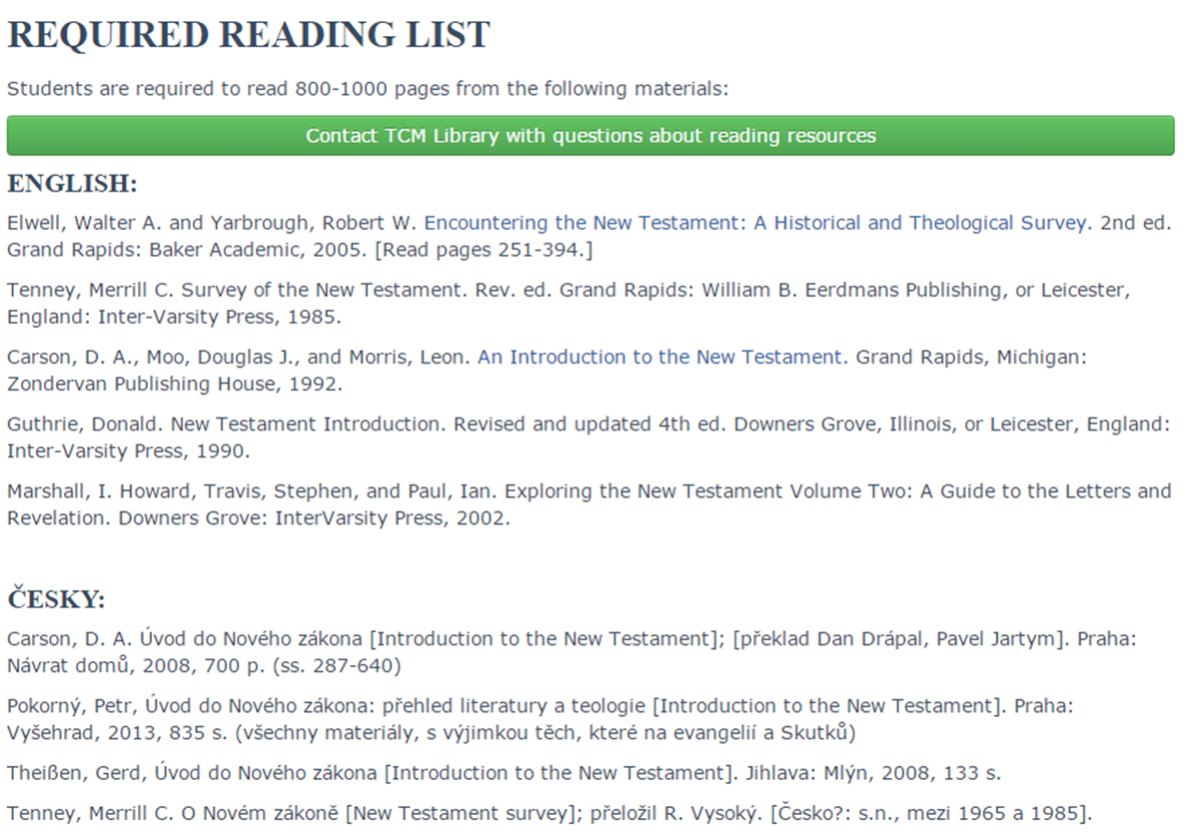

Slide 19
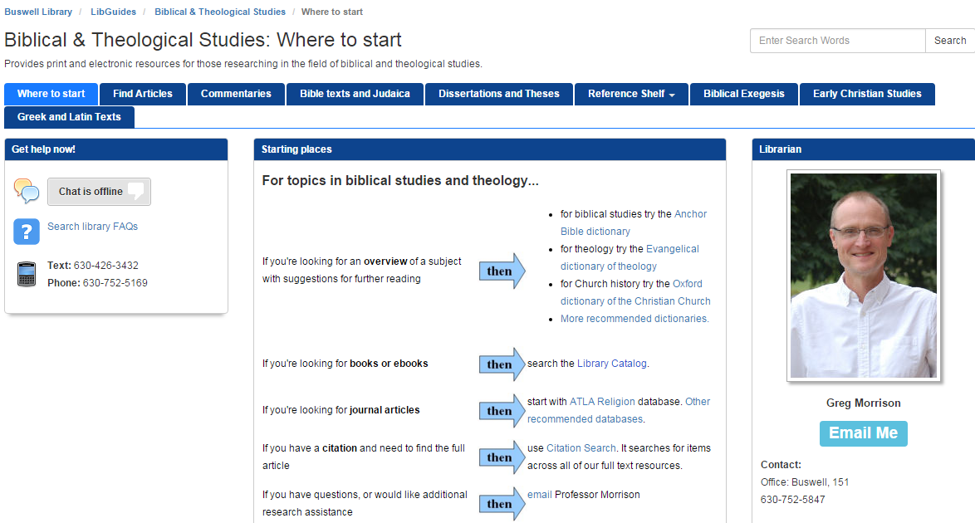
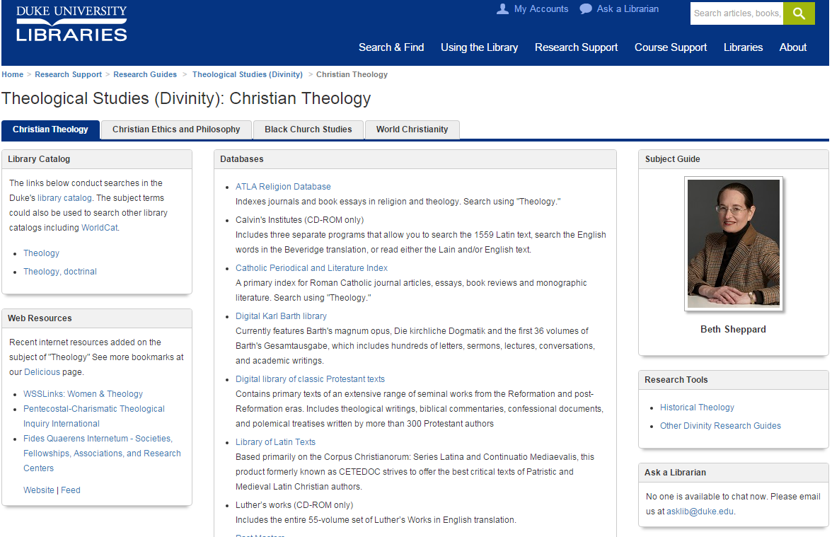

Slide 20
Library involvement on LMS
Macro-level (“library” course, link to library website, widget)
Micro-level (course-specific bibliographies, links to e-reserves, subject-specific LibGuides)
Forum, chat, Q&A corner (interactive as opposed to static)
Training (information literacy)

Slide 21
and back to collaboration…
Are we on the same page?

Slide 22
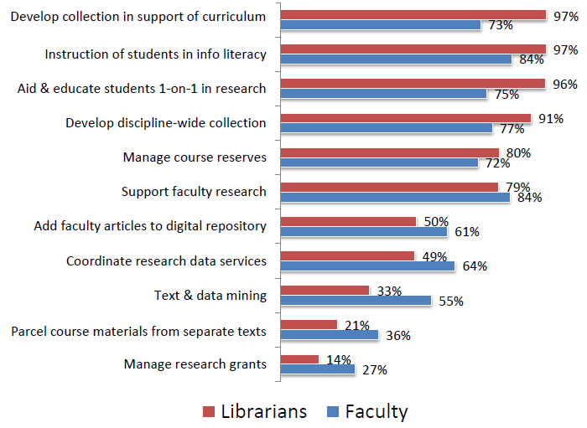
Faculty-librarians gap in academic library:
Librarian tasks
Library Journal and Gale, report from
www.thedigitalshift.com/research

Slide 23
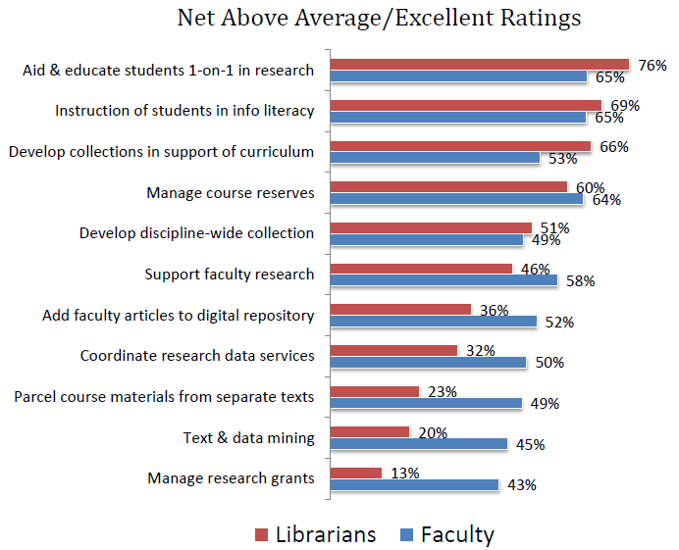
Faculty-librarians gap in academic library: self and other perception
Library Journal and Gale, report from
www.thedigitalshift.com/research

Slide 24
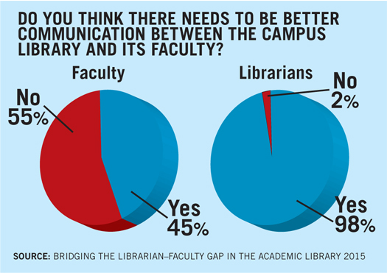
Faculty-librarians gap in academic library: communication
Library Journal and Gale, report from
www.thedigitalshift.com/research

Slide 25
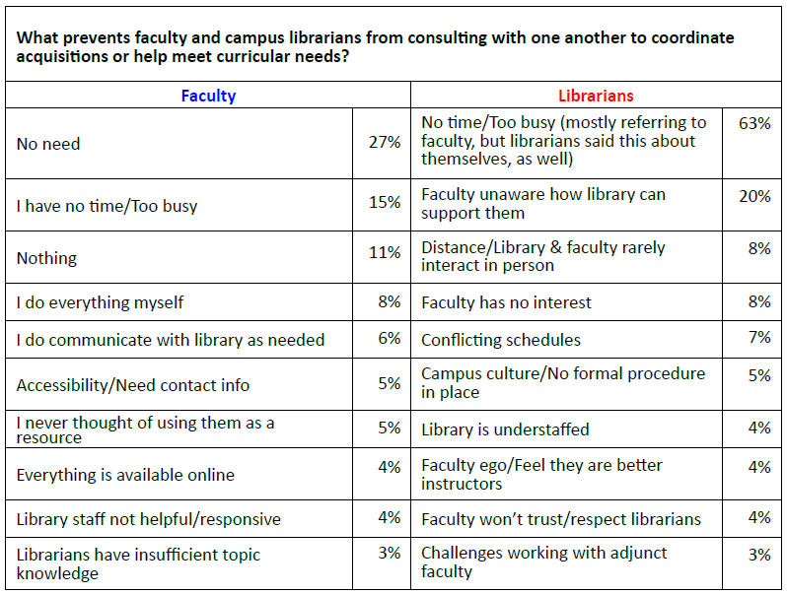
Faculty-librarians gap in academic library
Library Journal and Gale, report from
www.thedigitalshift.com/research

Slide 26
Change possible?
For librarians
Change of ethos and attitude
Conversation partners
Educators – translators
Proactive involvement
Inform and communicate

Slide 27
Change possible?
For faculty
Get information, communicate
Get librarians on respective committees
Collaborate in resources, training
Balance content delivery with teaching research skills

Slide 28
Bibliography
Delaney, J.G., Johnson, A.N., Johnson, T.D. & Treslan, D.L. (2010) Students' Perceptions of Effective Teaching in Higher Education. St John's, NL: Distance Education and Learning Technologies.
ACRL (Association of College and Research Libraries). “Standards for Distance Learning Library Services”, http://www.ala.org/acrl/standards/guidelinesdistancelearning
“Bridging the Librarian-Faculty Gap in the Academic Library.” Get PDF from www.thedigitalshift.com/research.
Schwartz, Meredith. “Closing the Gap in Librarian-Faculty Views of Academic Libraries.” Library Journal, September 1, 2015. http://lj.libraryjournal.com/2015/09/academic-libraries/closing-gap-librarian-faculty-views-research/#_

Slide 29
Resourcing learning in a globalized world
Theological libraries

