Slide 1
The Stewardship Crisis in Theological Education
Dr. R. Scott Rodin, President, The Steward’s Journey
Dr. Emmanuel Chemengich, Executive Director, ACTEA
ICETE Conference 2015

Slide 2
The Importance of Teaching Steward Theology as Part of Pastoral Preparation
Key Questions
How important is it that our pastors and leaders understand Steward Theology if they are to have an Impact?
How important is it that they are equipped to lead their congregations on the journey of becoming faithful stewards?
How critical is it that they are on this journey themselves?

Slide 3
What is Steward Theology?
God’s absolute ownership of all things
  Created us for whole relationships at four levels
    Our relationship to God
    Our relationship to our self
    Our relationship to our neighbor
    Our relationship to creation
In each relationship He created us to be stewards, caretakers in His name and for His purpose and glory

Slide 4
What is Steward Theology?
God’s redemption of all things in Christ

Slide 5

What is Steward Theology?
One-Kingdom people
  Everything under God’s Lordship
    Our relationship with God
    Our self-image, awareness and confidence
    Our relationships with our neighbors, to love as God loves us
    To creation: our time, talents, resources, and creation itself
For pastors this means
    Our congregations are His
    Our finances are His
    Our programs are His
    Our time as pastor is His
    Our future is His

Slide 6
What is Steward Theology?
We live in two kingdoms: God’s and ours
  In Eden we chose a kingdom for ourselves
Three temptations:
    Trust in ourselves
    Take control ourselves
    Play the lord over our own kingdom (our church?)
In this second kingdom we are rewarded with bondage
    Fear, stress, uncertainty, discouragement, anxiety, despair and depression all flow from our own thrones
    What we seek to own ends up owning us
    We become enslaved to all we call our own
    If the enemy can’t make us unfaithful he will settle for making us ineffective

Slide 7
What is Steward Theology?
Steward Theology is introducing God’s people to the journey we are on from two-kingdom bondage to one-kingdom freedom
  Stepping off the thrones of our kingdoms and surrendering everything back to God
  Return to one-kingdom living
  The journey from one to the other = discipleship
  From bondage to freedom and joy
  All about lordship, surrender

Slide 8
The Importance of Teaching Steward Theology as Part of Pastoral Preparation
Key Questions
How important is it that our pastors and leaders understand this theology?
How important is it that they are equipped to lead their congregations on this journey?
How critical is it that they are on this journey themselves?

Slide 9
The Importance of Teaching Steward Theology as Part of Pastoral Preparation
Have we failed to teach steward theology as part of our preparation of pastor leaders?
ICETE/GGN 2014 Survey Results

Slide 10
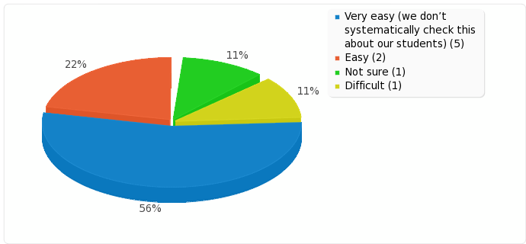
ICETE/GGN Survey Results
    How easy or difficult is it for a student to graduate from your institution even though he/she had not developed good habits of personal financial management and giving?

Slide 11
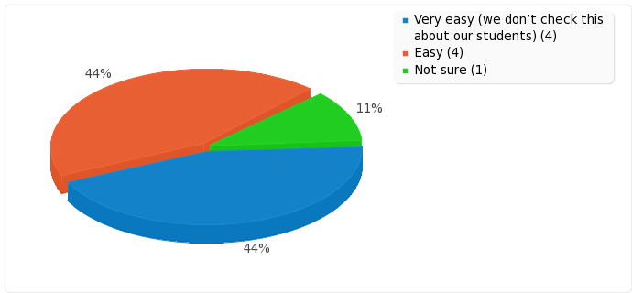
ICETE/GGN Survey Results
    How easy or difficult is it for a student to graduate from your institution without being able to preach/teach on Biblical stewardship, generosity and financial giving?

Slide 12
ICETE/GGN Survey Results
    ‘Rate the frequency of teaching on stewardship, generosity and financial giving in your country’ (1=Very seldom to 5=Very regularly)

Slide 13
ICETE/GGN Survey Results
    ‘Rate the quality of teaching on stewardship, generosity and financial giving in your country’ (1=Very Weak to 5=Very Strong)

Slide 14
The Importance of Teaching Steward Theology as Part of Pastoral Preparation
How might it best be taught? Woven into all theological disciplines
  Doctrine of Creation: relationships and stewardship
  Doctrine of the Fall and Redemption: Life as gift
  Discipleship: intimacy with God and walking with Him
  Pastoral Care: setting our people free
  Service: Loving our neighbor and our creation
  Ecclesiology: Work of the Church
  Eschatology: Matthew 25:14-28

Slide 15
The Importance of Teaching Steward Theology as Part of Pastoral Preparation
What is at Stake if we Fail to Teach Steward Theology?
Continued materialism and bondage
Cult of wealth and prosperity gospel
Weak discipleship: no third conversion
Loss of opportunity for evangelism
Limited and joyless generosity
Church’s capacity to advance God’s kingdom

Slide 16
The Importance of Teaching Steward Theology as Part of Pastoral Preparation
Key Questions
Why are we where we are today?
How important is it that our pastors and leaders understand this theology if they are to have an Impact?
How important is it that they are equipped to lead their congregations on this journey?
How critical is it that they are on this journey themselves?
How can we help ICETE institutions teach steward theology?
Discussion

Slide 17
Website
www.thestewardsjourney.com

