Slide 1
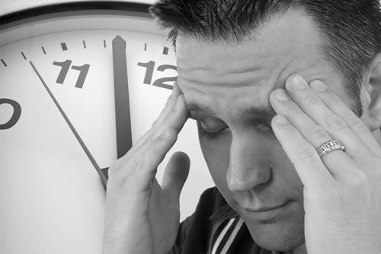
THE CHALLENGES OF
INSTITUTIONAL CRISIS MANAGEMENT
EEAA General Assembly Seminar
London, 28 October 2011
Dr. Paul Sanders

Slide 2
0.0 INTRODUCTION
SEMINAR OBJECTIVE: Sharing of ways and means of solving our institutional crises, by focusing on increased understanding of their nature and on strategies put in place by the leader.

Slide 3

DEFINITIONS:
Crisis: a process of transformation where the old system of the theological school can no longer be maintained, thus the need for change.
Crisis management: the process by which a theological school deals with a major event that threatens to harm the organization or its stakeholders.

Slide 4
The Nature of Crisis Management
Crisis management generally involves:
  (a) a specific threat to the college
  (b) the threat as an unanticipated surprise (c) a very short turnaround time for decision.
Crisis management often involves dealing with threats after they have occurred.
Crisis Management necessitates leadership able to identify, assess, understand, and cope with the serious situation at hand.

Slide 5

1.0 CASE STUDY:
«A Multifaceted Institutional Crisis»
Recently retired from a long and fruitful experience as a theological college administrator, you have accepted to become interim principal for one year of a college in crisis.
This crisis includes, among others, the following elements:
  An operating budget in the red.
  A deteriorated relational climate among faculty, staff & administration
  A laissez-faire board
You have one year to redress the situation. It appears that the survival of the college is at stake:
  Where do you start to remedy the situation?
  In what order would you address the crisis issues before you?
  What must be in place before you leave the institution?
  What biblical examples/principles could help you?

Slide 6
Small Groups (1)
Start with the board, support for everything else.
Understand the problem,
Relationships with the staff, biblical principles
Potential for new growth

Slide 7
Small Groups (2)
Start with finding facts: faculty first, individually, then into groups
Renew the vision of the school
Understand the funding loss (books)
Notify the board re: actions being taken, see their reaction
Explore with incoming president, outline with board & top administrators clear communication channesl
Nehemiah, Philippians 2: respect

Slide 8
Small Groups (3)
Understand relationship problems, (organigramme)
Support from the board – a condition for the acting principal to stay (responsibility)
Meet employees, senior first, personal then in groups
Communication with the students
Budget: balance it ASAP
Nehemiah, Acts 6, 15
Restructure board & staff
Succession or more time

Slide 9
Lessons learned (group)
Communication lack, disparity (students, staff), signs to people to feel secure that better things are happening
Find someone who is truly objective and trustworthy – extremity of views on both sides. Confidential advisors, aware of the school to whom anyone can go. Cultivate these advisors
Unclear division of labor between governance & management breeds pbs
Crisis management plan needed
Help the elephant get moving,
Avoid sacking the CEO (if possible)
Attitudes in dealing with the situation are all-important (dealing graciously, wisely)
Get the facts ! Pbs based on inaccurate information
Proactive, prevention – symptoms
Spokesperson authorised
Taking initiative for benefit of others – remember relationships
Privilege competence over goodwill in board composition – careful of unbalanced boards (i.e. only businessmen)
Crisis = time for change, for the most part: understand the problem, not only the solution – name the things that are not positive
If institutons are ruined, so are people with it
Don’t waste a good crisis as an opportunity for change, but not all change is positive

Slide 10
2.0 A MEDICAL PARADIGM
1. Prevention
2. Emergency Treatment
3. Symptoms
4. Diagnosis
5. Treatment

Slide 11
PREVENTION
Disease is the result of :
  Neglect
  Genetics
  Untreated disease
Accreditation as Prevention: to systematically identify gaps, weaknesses, threats, in order to transform them into strengths and opportunities.

Slide 12
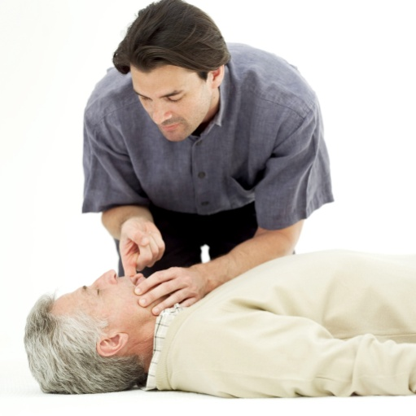
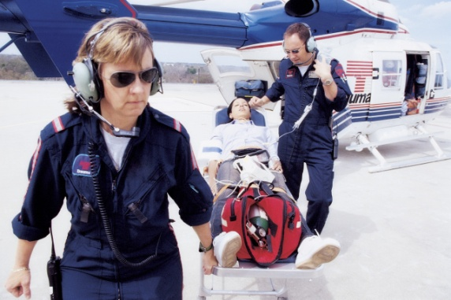
Emergency treatment
(crisis intervention)
First Aid, Emergency services: Help the patient survive
Emergency analysis & action: to stabilise the patient
Preliminary study
If necessary, call upon external emergency services

Slide 13
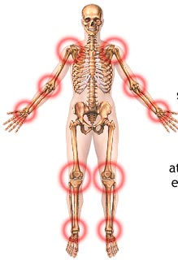
SYMPTOMS (testing)
Natural: earthquake, tsunami, etc.
Financial: symptomatic of root causes.
Political: pressure, harassment, persecution
Economic: critical lack of funding due to a national economic crisis
Governance: our board: institutional backbone or Achilles heel ?
Relational: close relation – crisis and conflict resolution
Historical: a necessary evolution in institutional development

Slide 14

DIAGONOSIS
Observing signs, symptoms, medical history...
Testing the patient re: the above
Concluding and moving to the next step

Slide 15
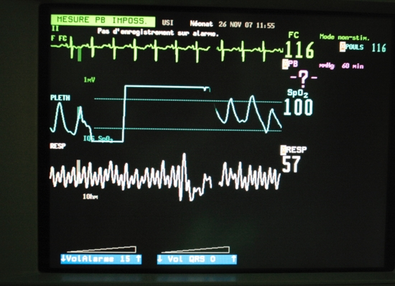
TREATMENT (Therapy)
Proper diagnosis
Ppatient willingness
Monitoring system for ongoing care & prevention

Slide 16

3.0
LEADERSHIP IN CRISIS

Slide 17

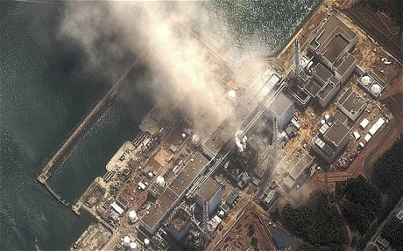
Two kinds of Crisis
Two kinds of crisis (Erika Hayes James):
sudden (beyond the institution’s control);
smouldering (from some form of negligence)

Slide 18
Phases of Crisis
Each phase requires specific crisis leadership competencies and character qualities :
  Early-Warning Signal Detection
  Preparation and prevention
  Containment and damage control
  Recovery
  Learning

Slide 19

Crisis Leadership Competencies
Building an environment of trust
Reforming the organization’s mindset
Identifying vulnerabilities of the organization
Taking wise & rapid decisions and courageous action
Learning from crisis to effect change.
Good crisis leadership reflects the capacity of an organisation for sustainability

Slide 20
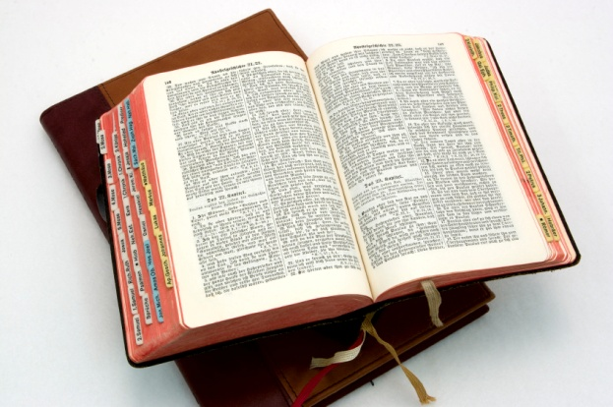
Biblical Examples:
Decisive action in crisis
Joseph : managing famine
Moses : managing liberation, rebellion, succession
Nehemiah : managing renovation
Esther : preventing genocide and managing the future of an exiled people
Apostles (Acts 6 & 15) : preventing/ managing dissension and potential division in the early Church

Slide 21

4.0
PRACTICAL PRINCIPLES
OF CRISIS MANAGEMENT

Slide 22
ATTITUDE
See crisis by seeing it as an opportunity for institutional development and growth
Recognise that the current crisis may be the result of the failure to prepare for crisis. “If we fail to prepare for crisis, we prepare to fail” (the importance of prevention)

Slide 23
ANALYSIS
Identify the scale of the problem – to what extent has the disease spread?
Obtain multiple opinions in the decision making process (wisdom in multiple counsellors): A wide spectrum of people, including external people who are experienced in crisis management and not involved emotionally with the problem/situation and have no conflict of interest in becoming involved.

Slide 24
COMMUNICATION
To STAKEHOLDERS: Manage crisis as an opportunity to recover stakeholder trust, through proper communication – silence is your worst enemy (this relates to the communication culture of the institution). Reassure your stakeholders that you intend to rectify the situation and prevent it in the future (therapy and prevention)
To OTHERS (collateral damage): Apologise to whom apology is due (true apology, not the false apology of “I regret any inconvenience I may have caused”)

Slide 25
REFERENCES
"Crisis Leadership". http://papers.ssrn.com/sol3/papers.cfm?abstract_id=1281843&rec=1&srcabs=224055.
James, E. (Spring 2007). "Leadership as (Un)usual: How to Display Competence In Times of Crisis". Leadership Preview. http://www.leadershipreview.org/2007spring/Article4.pdf. Retrieved 2010-06-22.
James, E.; James, E. H. (Vol. 10, No. 3, 2008). "Linking Crisis Management and Leadership Competencies: The Role of Human Resource Development". Advances in Developing Human Resources 10 (3): 352. doi:10.1177/1523422308316450. http://adh.sagepub.com/cgi/content/short/10/3/352. Retrieved 2010-06-22.
Holmes, Anthony, “7 Principles of Crisis Management”, http://anthonyholmes.org/7principles.aspx.
James, Erika; Lynn Wooten (2010). Leading Under Pressure. Routledge Academic.

